Slide 1
Access 2016 Module 11
Creating Advanced Reports

Slide 2
Module Objectives
Apply advanced formatting
Control layout
Set advanced print layout
Create multicolumn reports
Use domain functions
Create charts
Modify charts
Apply chart types

Slide 3
Apply Advanced Formatting (Slide 1 of 2)
Modify the layout and characteristics of individual controls on a report
Layout modifications
e.g., margins and page orientation
Format property examples
Date formats
Medium Date or Long Date
Number formats
Currency, Percent, or Standard

Slide 4
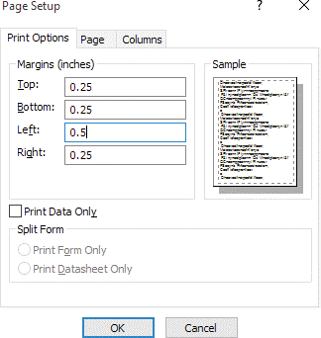
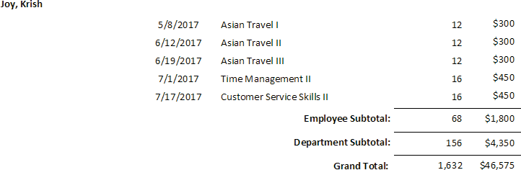
Apply Advanced Formatting (Slide 2 of 2)
Page Setup dialog box
Applying the Currency format

Slide 5
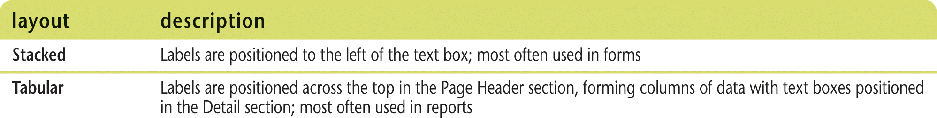
Control Layout (Slide 1 of 2)
Table layout
connects controls together
when one control is moved or resized in Layout or Design View, the action applies to all controls in the layout
Layouts

Slide 6
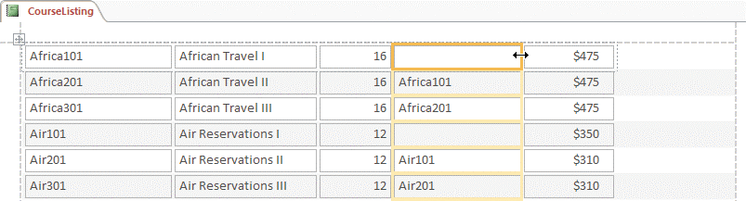
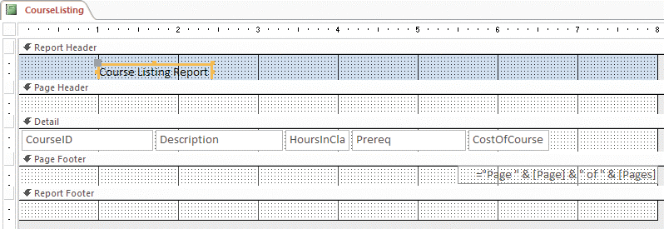
Control Layout (Slide 2 of 2)
Resizing columns in a layout
Opening sections in Design View

Slide 7
Set Advanced Print Layout (Slide 1 of 2)
Controlling print options
Page breaks
How report sections span multiple pages
Use Repeat Section property
Use Force New Page property
Preview report to confirm layout changes

Slide 8
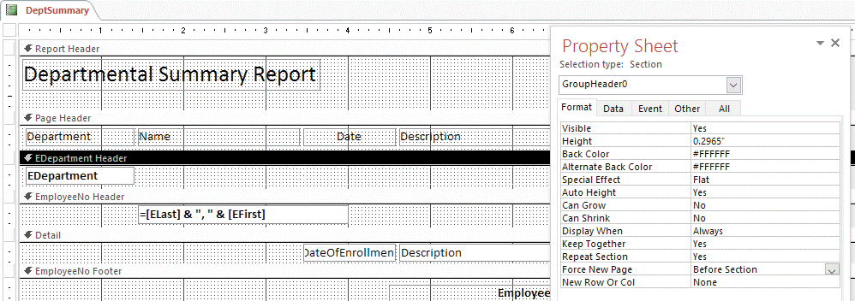
Set Advanced Print Layout (Slide 2 of 2)
Working with section properties in Report Design View

Slide 9
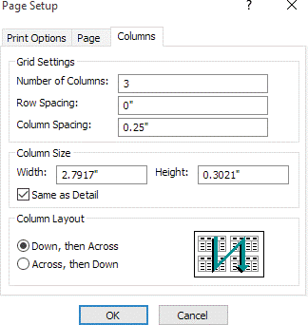
Create Multicolumn Reports (Slide 1 of 2)
Multicolumn report
Repeats information in more than one column on the page
Set up with options in the Page Setup dialog box

Slide 10
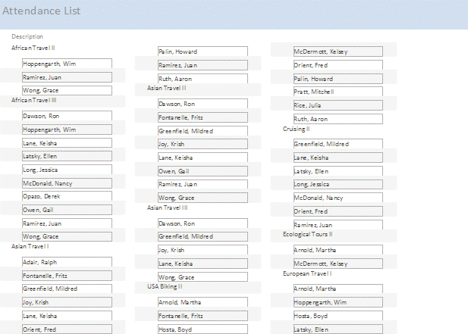
Create Multicolumn Reports (Slide 2 of 2)
Attendance List in three columns

Slide 11
Use Domain Functions (Slide 1 of 2)
Domain functions (aggregate functions)
Calculate a value based on a field not included in the Record Source property
Start with a “D” for “domain”; DSum, DAvg, or DCount, etc.
Perform the same calculation as their Sum, Avg, and Count counterparts
Two required arguments:
Field used for the calculation
Domain name
Domain - table or query that contains the field used in the calculation
Third optional argument
specify criteria to select records based

Slide 12
Use Domain Functions (Slide 2 of 2)
Adding page numbers or the date and time to a report
Click Page Numbers button on the Design tab of the Ribbon
Page Numbers dialog box prompts for format and location (Page Header or Page Footer)
Current date and time
Click Date and Time button on Design tabl
Select format
Always inserted on right side of Report Header section

Slide 13
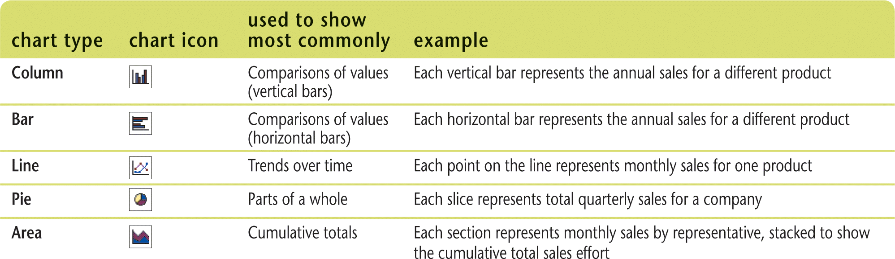
Create Charts (Slide 1 of 3)
Charts
Visual representations of numeric data
Insert charts on form or report
Access provides a Chart Wizard to assist in creating chart
Common chart types

Slide 14
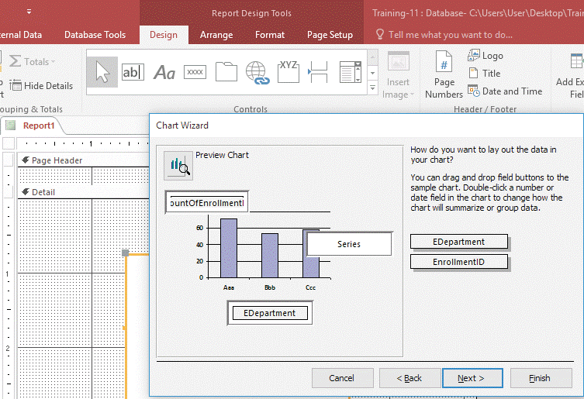
Create Charts (Slide 2 of 3)
Choosing the chart area

Slide 15
Create Charts (Slide 3 of 3)
Using Blank Report button versus Report Design button
Blank Report button
Creates a new blank report in Layout View
Report Design button
Creates a new blank report in Design View
Only difference is the initial view presented when you start building a new report

Slide 16
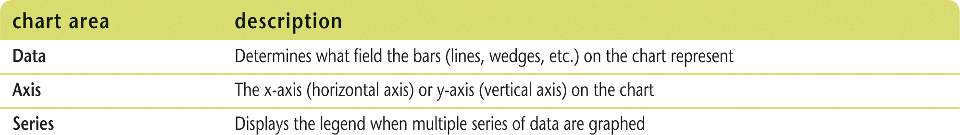
Modify Charts (Slide 1 of 2)
In Design View of the form or report that contains the chart
Doesn’t always show the actual chart values
Displays chart placeholder that represents embedded chart object
Modify the chart elements and chart areas within the chart placeholder
Use Form View or Print Preview to view chart changes for form or report
Chart areas

Slide 17
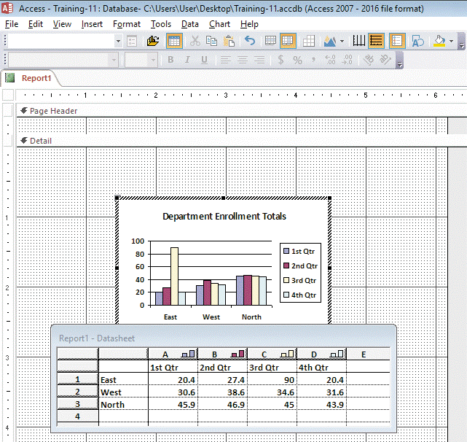
Modify Charts (Slide 2 of 2)
Editing a chart placeholder

Slide 18
Apply Chart Types (Slide 1 of 2)
Chart Wizard provides 20 different chart types
Column charts are most popular
Line, area, and pie charts can effectively show some types of data
Three-dimensional effects
Can enhance the chart; but also make it difficult to analyze chart data

Slide 19
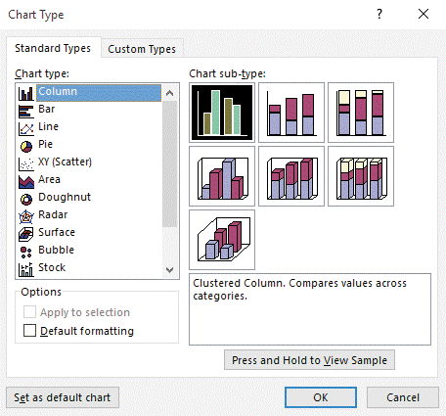
Apply Chart Types(Slide 2 of 2)
Chart Type dialog box

